Slide 1

It Power Consulting
The power of technology

Slide 2
What will you Discover?
Our Vision
Who are we?
What do we offer?
Our customer
Contact us

Slide 3
Our vision
We build trustful and long-lasting relations with our customers and clients.
We welcome different businesses seeking assistance for issues resolved by technological solutions.
We build our rapport by providing suitable and quality services to our client.
We prefer using an innovative and original approach in solving issues of business of all sizes and structures.
Our main focus is the contentment and gratification of our client.

Slide 4
Who are we?
It Power Consulting is the premium brand in Egypt providing you technology solution services.
This is the leading national brand solving various business
issues resulting in the effectiveness of the work. We prefer solving issues technically with fewer chances of error.
Our company believes in client satisfaction and contentment. We value our client’s opinions and consider them wholly.

Slide 5
What do we offer?
Odoo ERP:
1- Odoo For Restaurants
2- Odoo for Point of sale
3- Odoo for Real state Company.
4- Odoo for Hotel Management.
5- Odoo For Constructions
8- Odoo For Hospital Management
9- Odoo For Education Services
10-Odoo For Manufacturing Industries.
Web Design Services

Slide 6


Slide 7


Slide 8
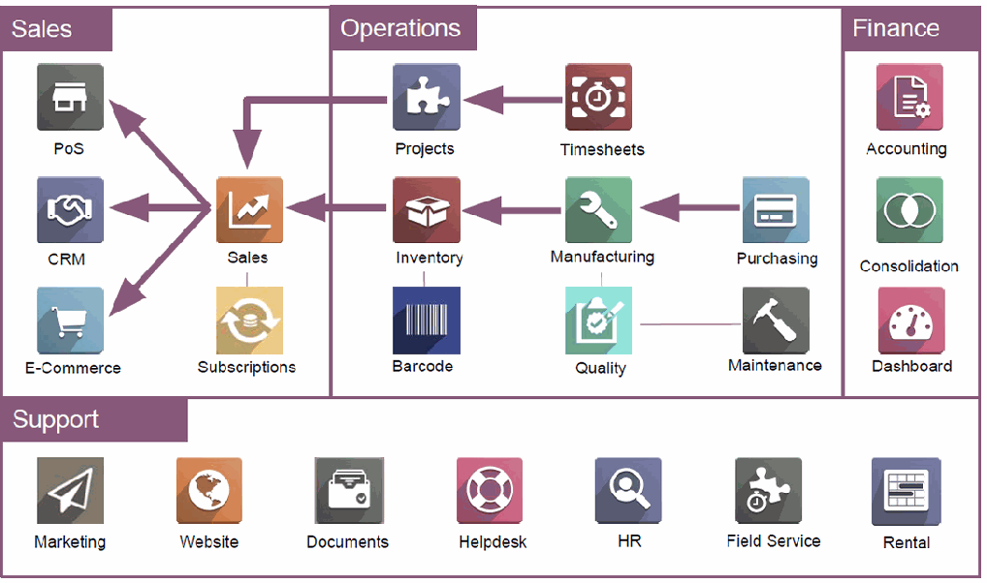
Some Of Odoo Modules :

Slide 9
Why Odoo ?
User-friendly interface( easy to use Arabic support)
Easy to customize according to business needs.
Scalable System
A modular structure
Fully integrated
Web-based Solution ( cloud or on premises )
Advanced integration to other platforms.
Wide range of Apps and modules

Slide 10
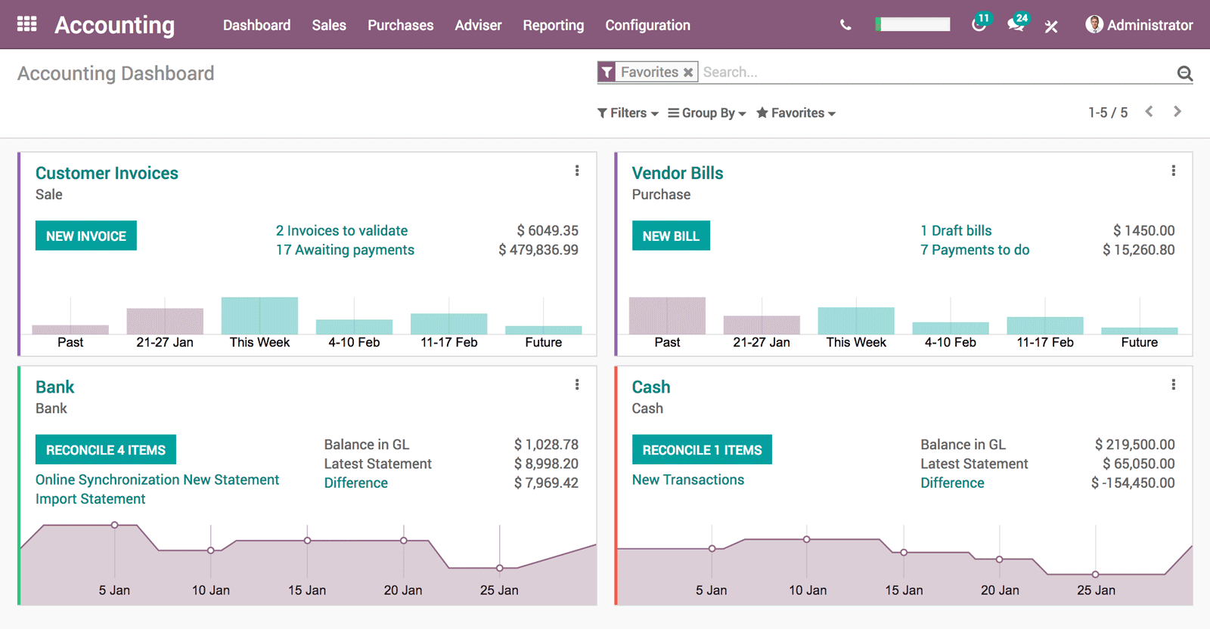
Accounting:
Accounts Receivable Account payables Bank & Cash Reconciliation
Fixed Assets
Reports and analytics Multi-currency support Multi companies Multiple users
Multi Journals
Multi Language Support ( Arabic)

Slide 11
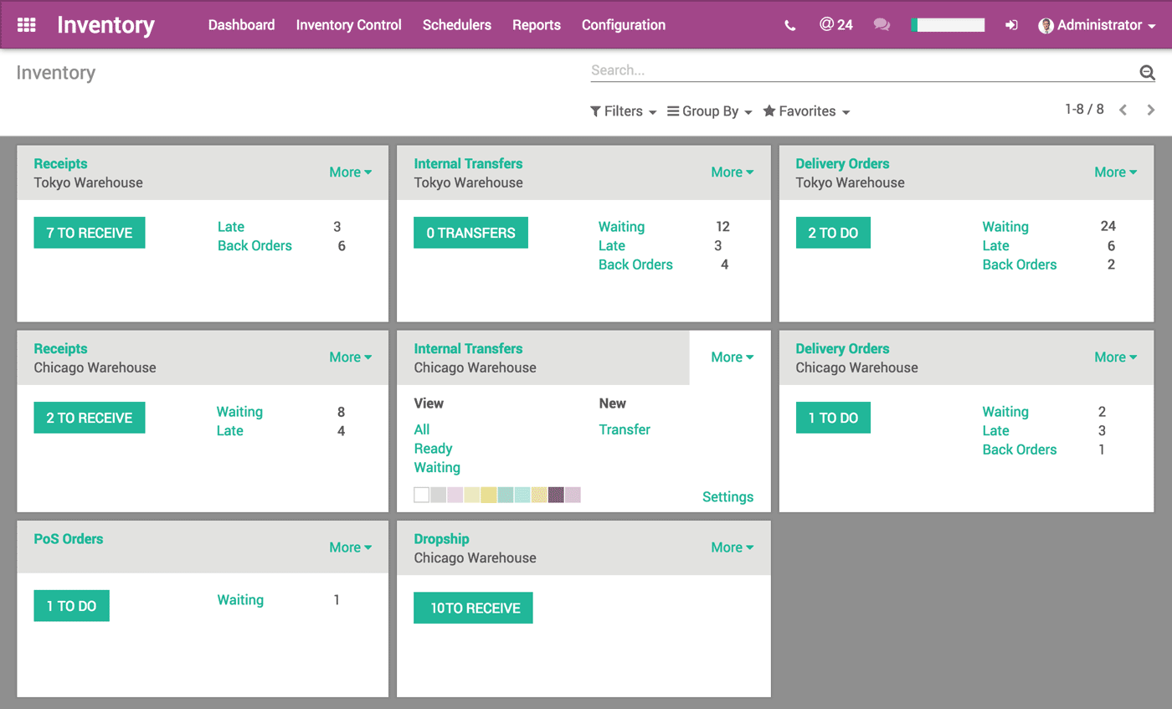
Inventory
Delivery Orders Inventory Adjustments Bar code Support Drop-shipping
Put away & Removal strategies
Minimum Stock Activity Log Expiration Dates
Multiple unit of measures
Inventory Valuation
Inventory

Slide 12
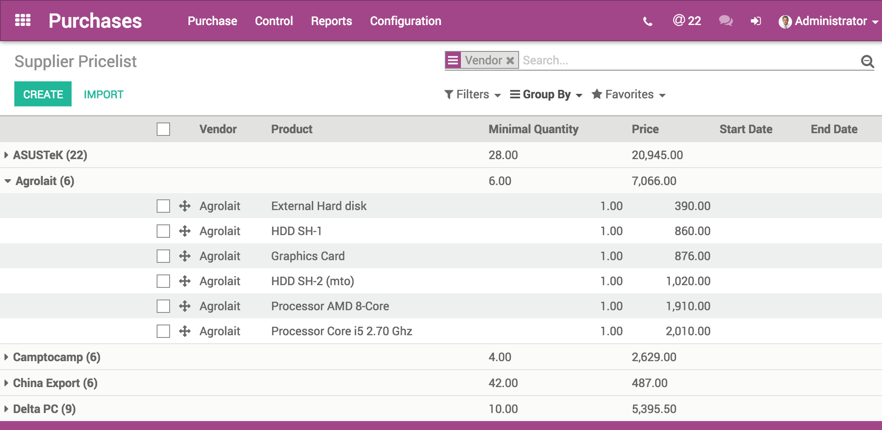
Purchasing:
Manage Orders & Contracts
Quotation Builder
Manage Invoicing from Sales Orders Manage Contracts
Product Types
Discounts
Units of Measure Product Configurator Schedule Activities Inter-Companies Rules Pricelists

Slide 13
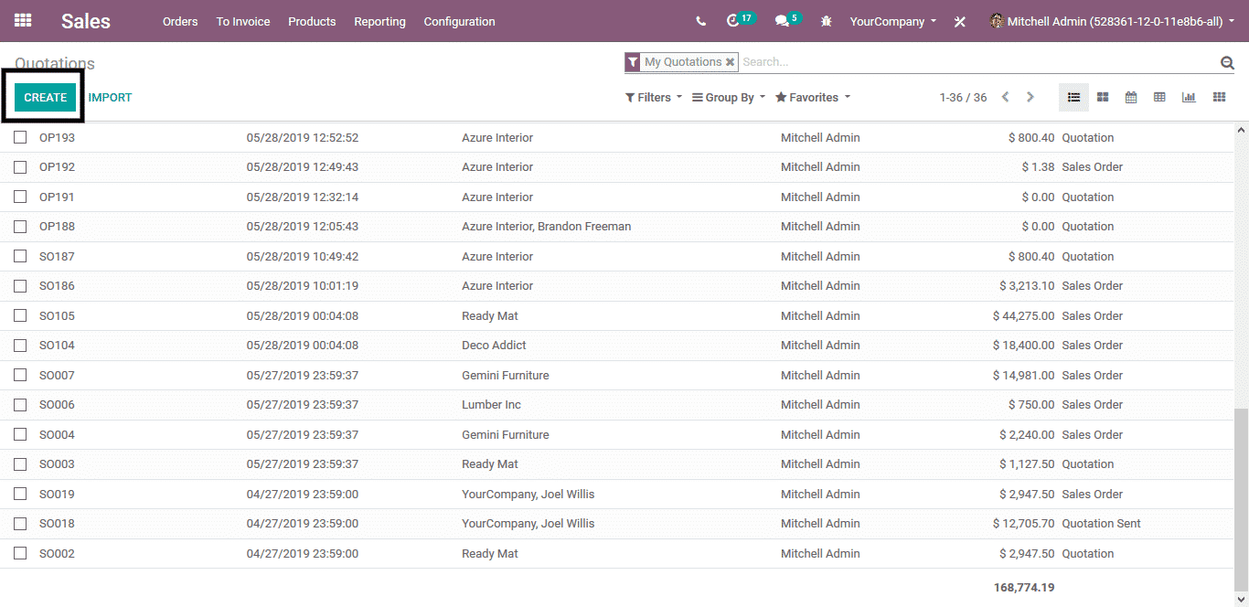
Sales:
Manage Orders & Contracts
Quotation Builder
Manage Invoicing from Sales Orders Manage Contracts
Product Types
Discounts
Units of Measure Product Configurator Schedule Activities Inter-Companies Rules Pricelists

Slide 14





Our Customers:

Slide 15




Contact us:
+2 01146577557
https://www.facebook.com/it.power.consulting1
info@itpowerconsulting.com
Nasr City:
3 Makram Ebid st , 6th Floor

